Slide 1
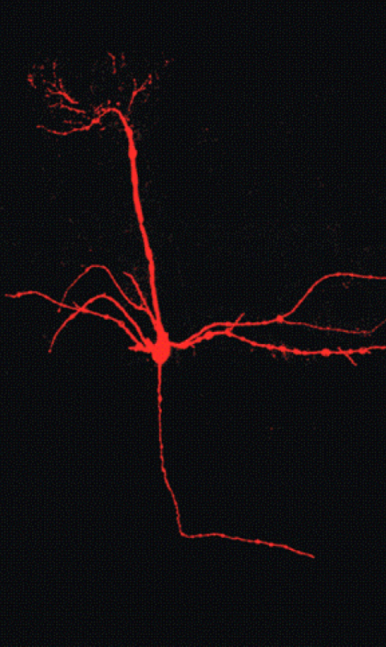
GROUP 4 : ALL-FACTORY RESET
Does the cellular compartmentalization of a neuron matter for its computation?
Local Feedback Via Dendrites
Abhishek , Debarpita, Rajkumar, Sanika, Shraddha
(Harvey & Heinbockel, 2018)

Slide 2
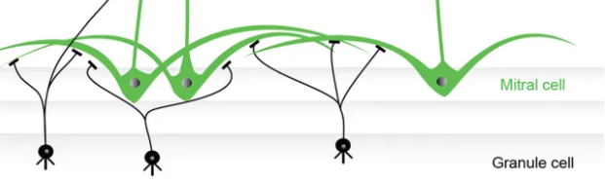
Project 6: Local Feedback via Dendrites
Create a neuron A with a large dendritic arbor and created two single compartmental neurons B and C and connected them reciprocally to A. Then compared the outcomes when:
B
A
C
The synapses B→A, A→B, C→A, and A→C are all to and from the same compartment of neuron A.
The scenario where they are on different branches of neuron A.
(Nagayama et al.,2014)

Slide 3
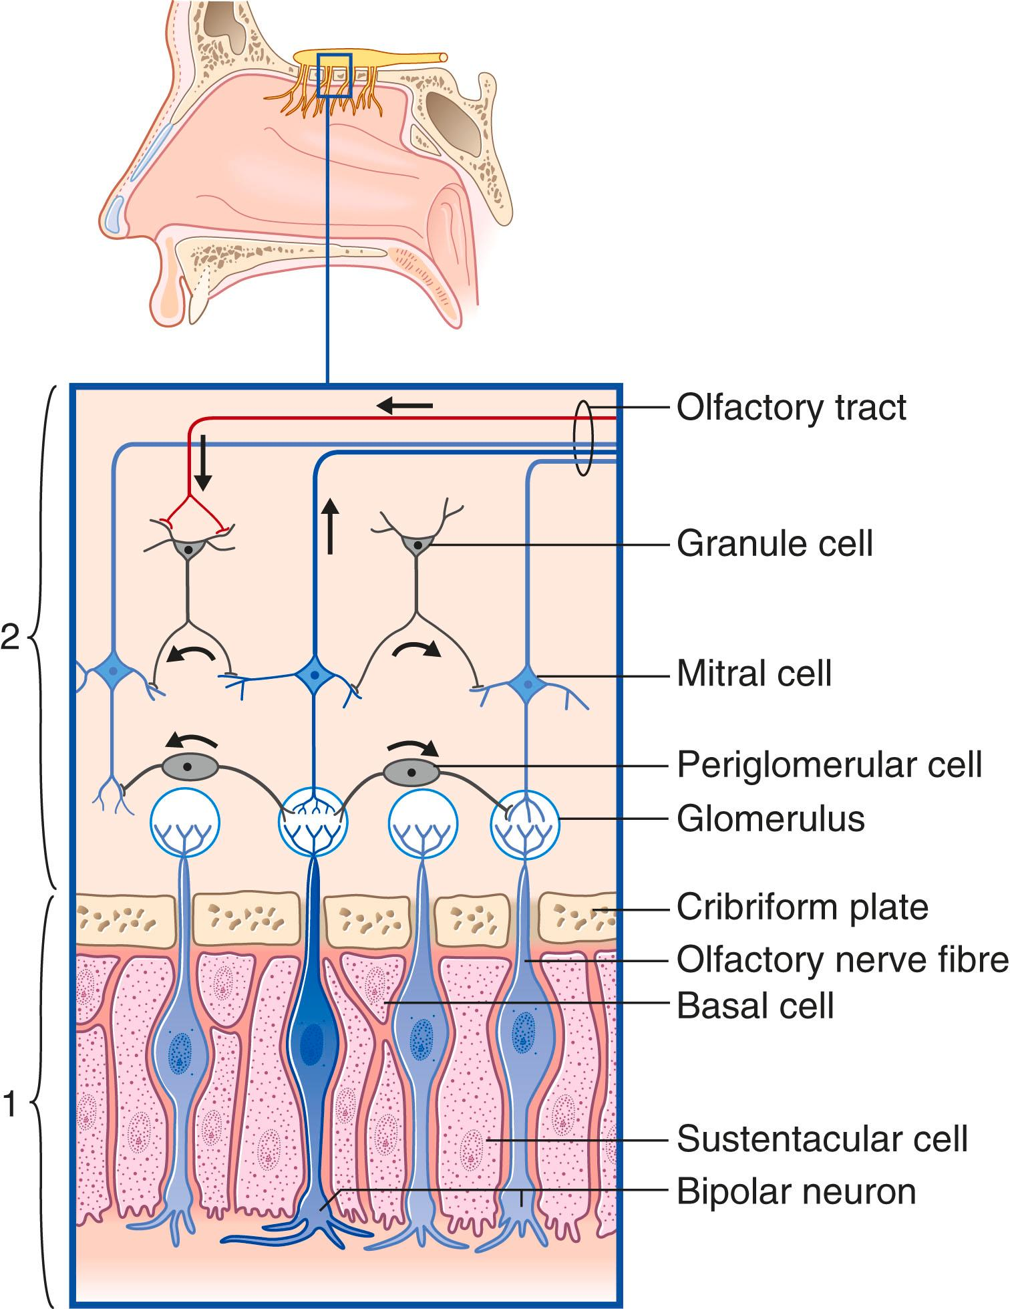
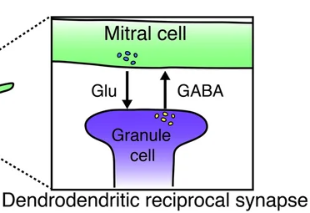
Mitral and granule cells have dendro-dendritic reciprocal synapses
(Sakamoto et al., 2014)
Granule cell
Mitral cell
Granule cell
(Neuroscience, 2024)
Notes:
(1).The somas of the primary afferent neurons occupy a surface epithelium. (2).The axons of the primary afferents enter the cerebral cortex directly; second-order afferents are not interposed. (3).The primary afferent neurons undergo continuous turnover, being replaced from basal stem cells. (4).The pathway to the cortical centres in the frontal lobe is entirely ipsilateral.
The olfactory system consists of the olfactory epithelium and olfactory nerves, the olfactory bulb and tract, and several areas of the olfactory cortex.
Contact between olfactory fibres and mitral cell dendrites takes place in some 2000 glomeruli , which are sites of innumerable synapses and have a glial investment, but each receives its input from sensory neurons that respond to the same stimulus ( odorant ). Glomeruli that are ‘on-line’ (active) inhibit neighbouring, ‘off-line’ glomeruli through the mediation of γ-aminobutyric acid (GABA)ergic periglomerular cells (cf. the horizontal cells of the retina), representing an initial stage of signal (specific odour) processing. Mitral cell activity is also sharpened at a deeper level by granule cells that are devoid of axons (cf. the amacrine cells of the retina), representing the next stage of signal processing and contrast enhancement between mitral cells. The granule cells receive excitatory dendrodendritic contacts from active mitral cells, and they suppress neighbouring mitral cells through inhibitory (GABA) dendrodendritic contacts.
Mitral cell output is not a passive reflection of their input from the olfactory nerve. In mice, each mitral cell sends a single primary dendrite into a glomerulus receiving input from a population of olfactory sensory neurons expressing identical olfactory receptor proteins, yet the odor responsiveness of the 20-40 mitral cells connected to a single glomerulus (called sister mitral cells)^{[1]} is not identical to the tuning curve of the input cells, and also differs between sister mitral cells.^{[2]} Odorant response properties of individual neurons in an olfactory glomerular module. The exact type of processing that mitral cells perform with their inputs is still a matter of controversy. One prominent hypothesis is that mitral cells encode the strength of an olfactory input into their firing phases relative to the sniff cycle. A second hypothesis is that the olfactory bulb network acts as a dynamical system that decorrelates to differentiate between representations of highly similar odorants over time

Slide 4
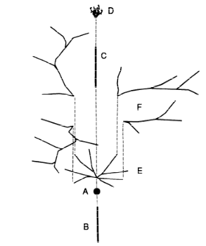
Modelling the Mitral Cell
Soma
Axon
Primary dendrite
Glomerular tuft
Proximal secondary dendrites
Distal secondary dendrites
(Harvey & Heinbockel, 2018)
Bhalla and Bower (1993)
Notes:
Since we choose Mitral cells - Granule cell motif we looked out for biophysical models of mitral cells
Prof Bhalla published a 286 compartment model

Slide 5
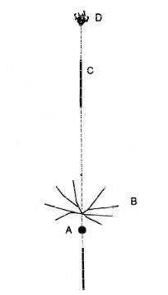
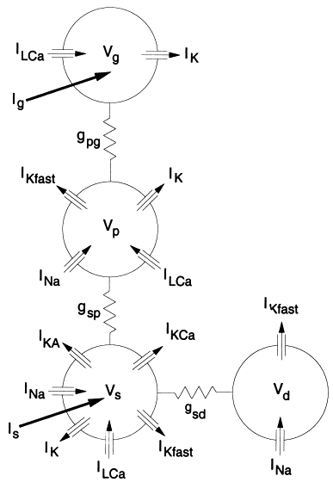
Reduced Model the Mitral Cell
Soma
Secondary Basal dendrite
primary dendrite shaft
Glomerular tuft
Bhalla and Bower (1993)
Davison et al. (2000)
Notes:
We choose a reduced 4 compartment model which best replicated the behavior of the previous 286 compartment model while running 75 times faster
These are the four compartments they used

Slide 6
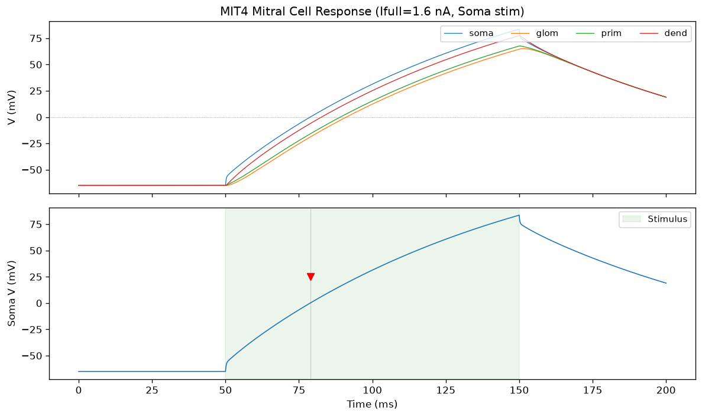
Passive model of mitral cell
Notes:
We removed all the active channels and used a passive leak model to understand the passive conductance across the compartments
When stimulated from soma and glomeruli compartment

Slide 7
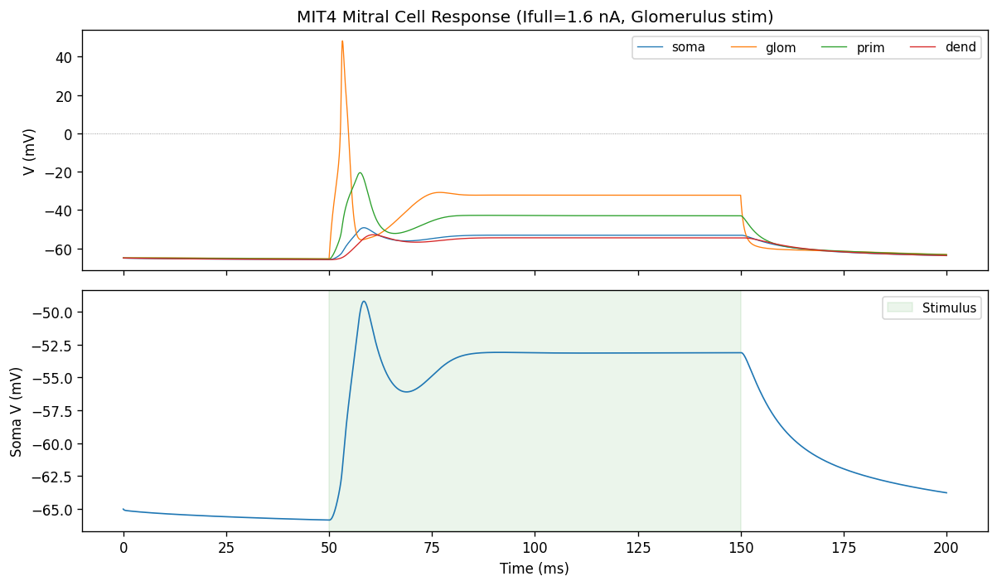
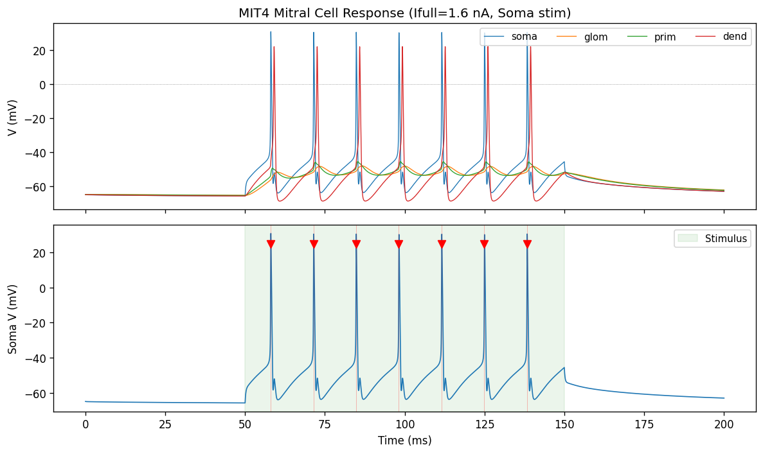
Active model of the Mitral Cell
Davison et al. (2000)
Notes:
Further we introduced the channels back and we had working simple biophysical model of mitral cells with huge dendritic arbour replicated to python frontend in neuron
but now we need to introduce the reciprocal connection to achieve our motif

Slide 8
Addition of Granule cells to the model
Properties of the granule cell added:
  Single compartment
  Spherical. (r = 7.5 µm)
  SA = 700 µm², cm = 1 µF/cm², Ra = 35.4 Ω·cm
  Passive membrane: I_{leak}​=g_{pas​}(V−E_{pas}​)
  g_{pas}= 0.0001 S/cm² (NEURON's default leak conductance)
  E_{leak}​= −65 mV
  HH active channels
It is not a detailed granule cell. It is closer to a generic spiking inhibitory interneuron.

Slide 9
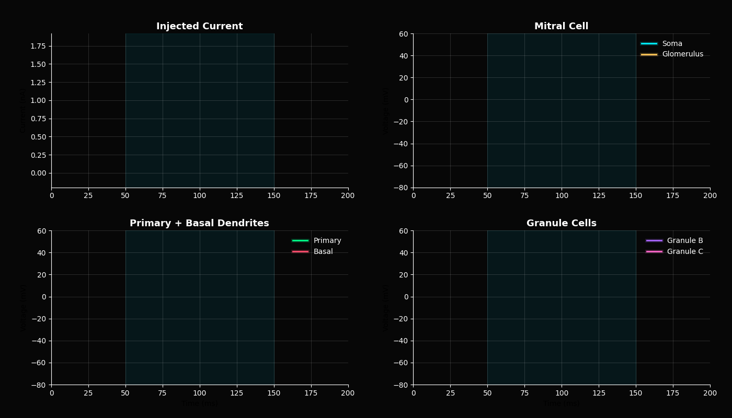
Addition of Granule cells to the model

Slide 10
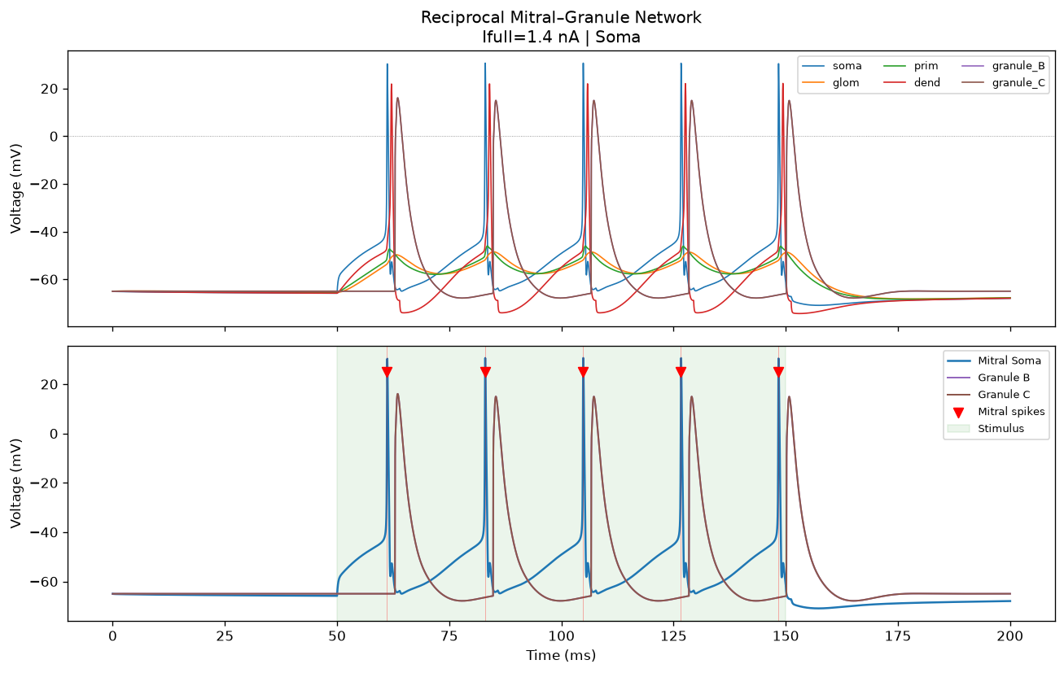
Granule cells’ firing latency is biologically accurate

Slide 11
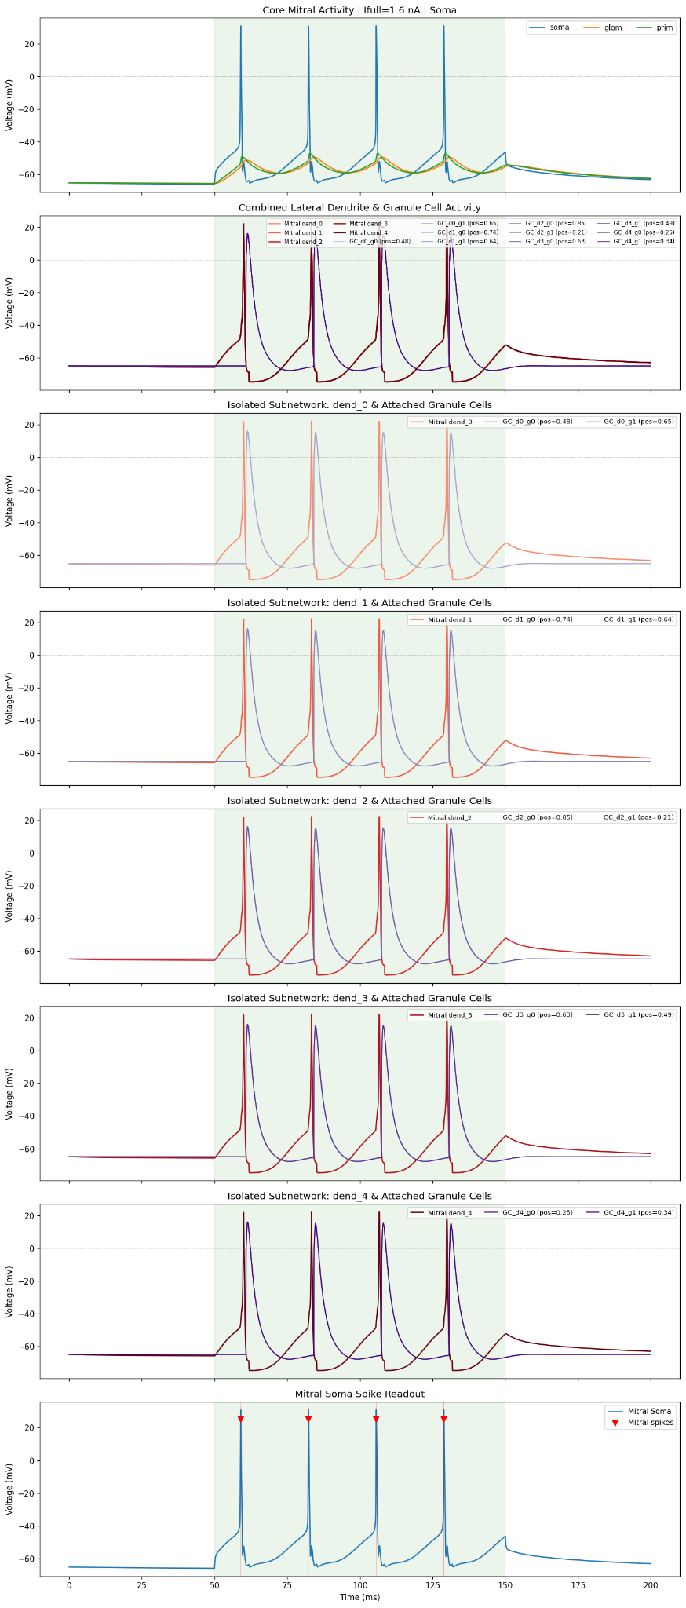
Various connections of GC does NOT reflect in their firing

Slide 12
Requirement of more biologically relevant model reflecting the connections in their activity!

Slide 13
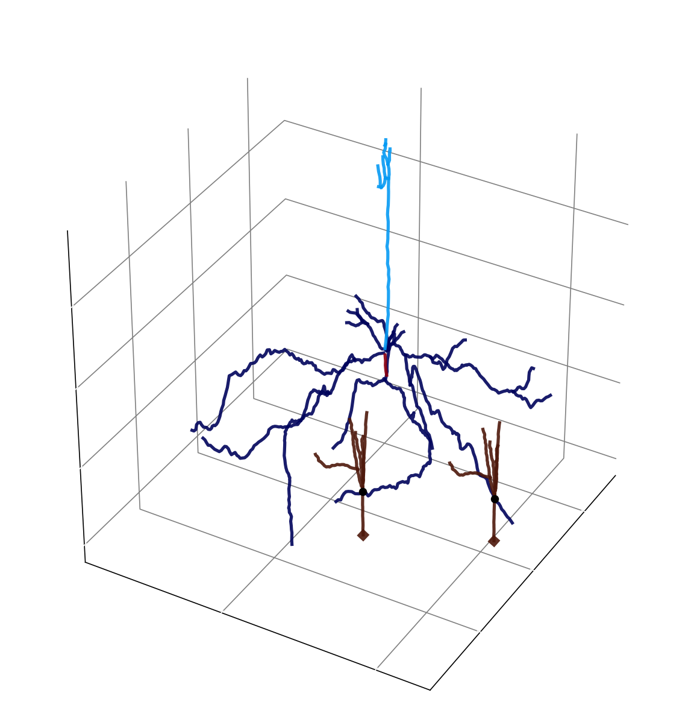
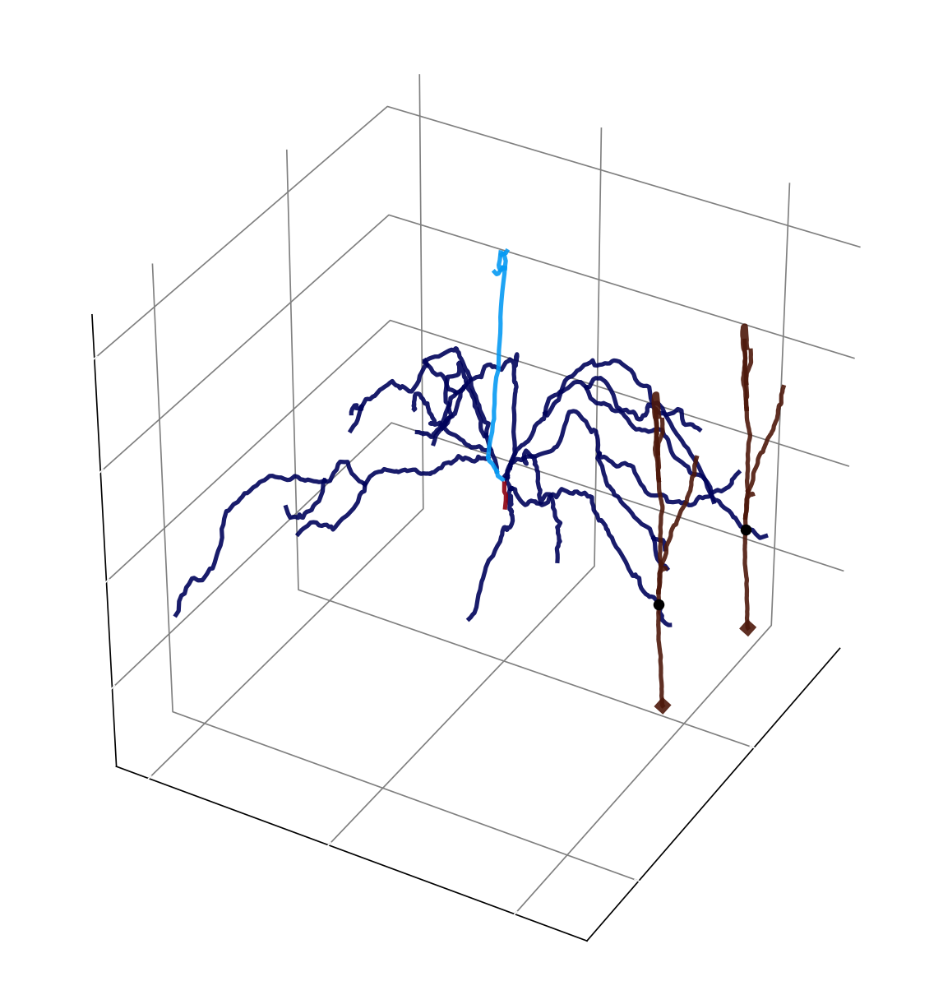
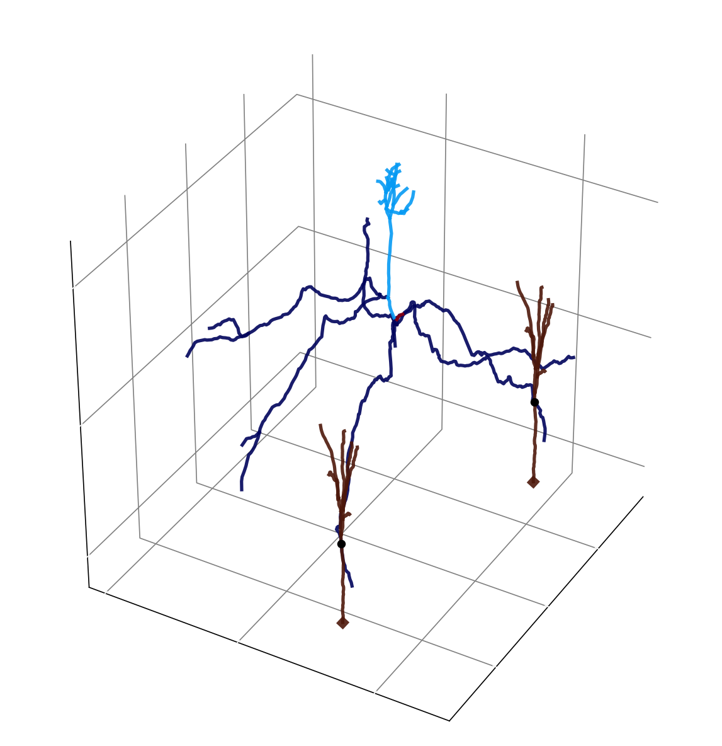
More complex morphologies
150 - 200 compartments in MC, 20-30 compartments in GC
Simulated 25 different motifs (5MCs, 5GCs)
Mitral Cell (MC1) Ion Channel Distributions
  Somatic: KA, KCa, Kd, Kslow, LCa, Na
  Apical: CaT, Ih, KA, KCa, Kd, Kslow, LCa, Na
  Basal: KA, KCa, Kd, Kslow, LCa, Na
  Axonal: KA, KCa, Kd, Kslow, LCa, Na
Granule Cell (GC1) Ion Channel Distributions
  Somatic: KA, Kd, KM, Na
  Apical: Kd, Na
Code from https://github.com/JustasB/OlfactoryBulb/’

Slide 14
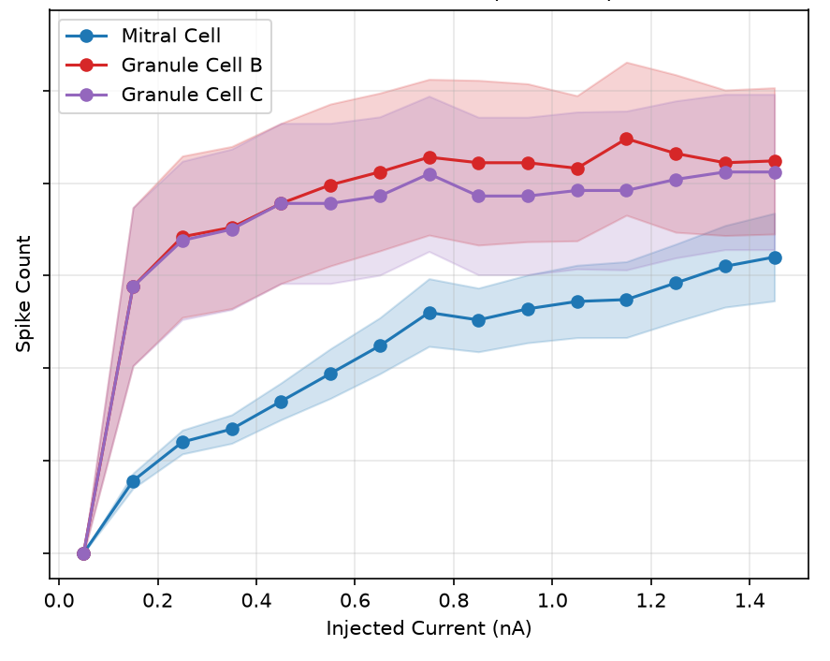
f-I curve
Injected current at the glomerulus and recorded voltage at the soma of all three cells
B
A
C

Slide 15
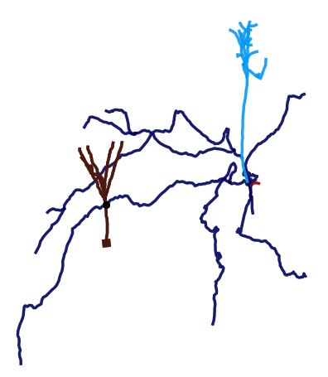
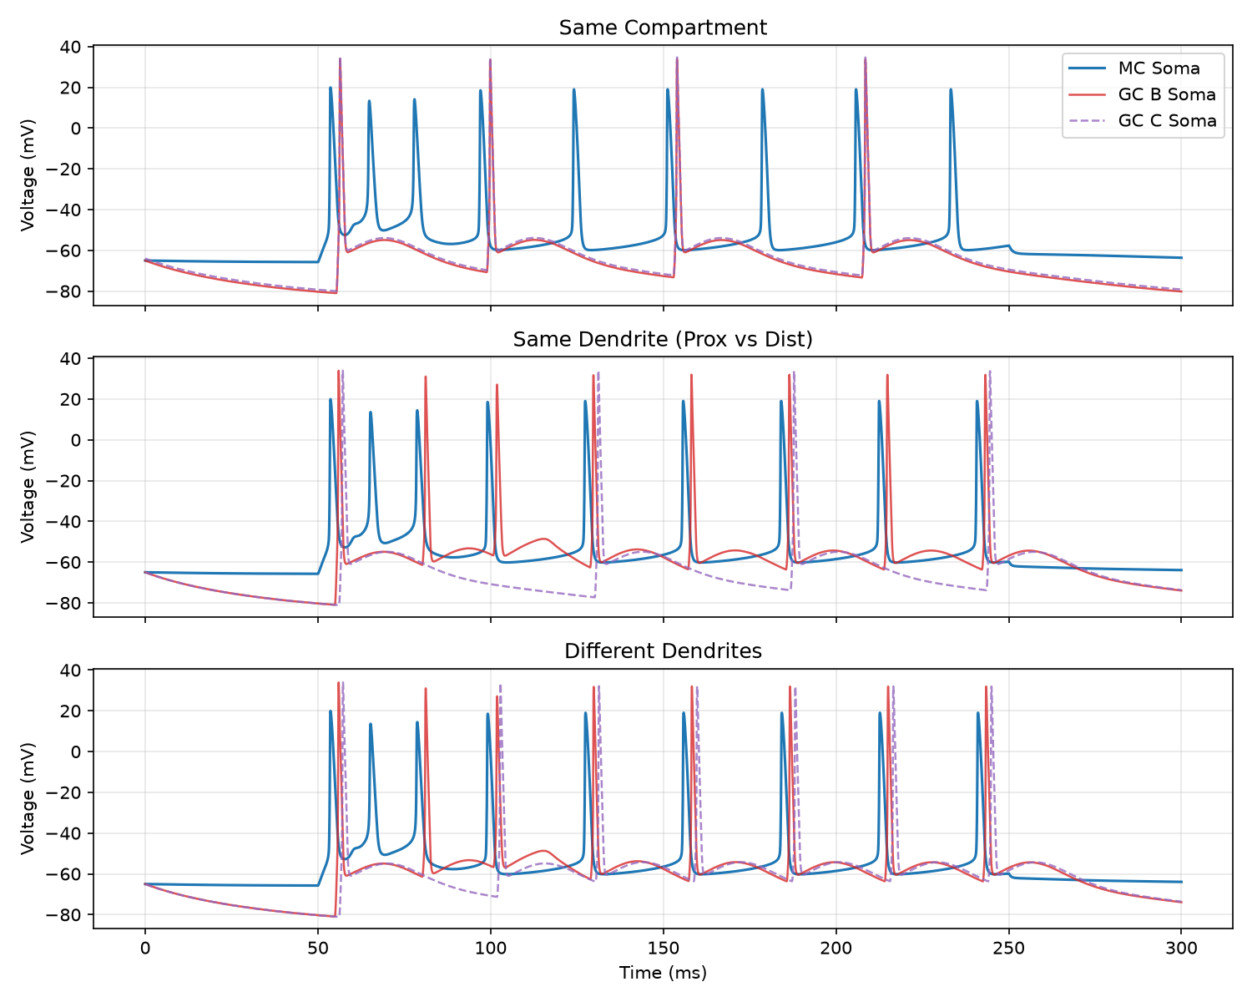
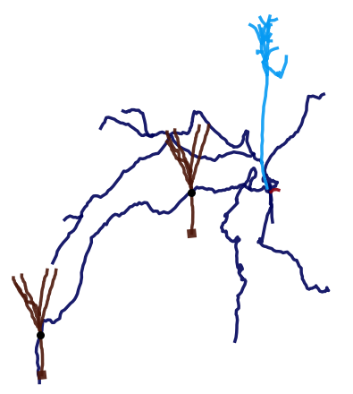
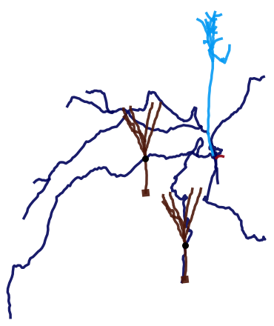
Localisation of MC-GC synapses

Slide 16
Conclusion :
Circuit design: 1 mitral cells (large dendritic arbour) ↔ 2 granule cells , reciprocally connected — to study local feedback via dendrites
Passive & Active model: 4 compartmental MC + single-compartment granule cells (HH)
Previous model lacks structural accuracy → moving to morphologically realistic mitral & granule cell model.
We studied local feedback in olfactory mitral cells and granule cells.
Connections of GC on the same dendritic branch of MC, lead to a stronger inhibition than on different branches/distances of the same compartment of MC.
The various compartments of the cell matters for its computations!
Notes:
We worked on a model consisting of 2 neurons which has reciprocal connections to 1 neuron with large dendritic arbor to study the local feedback via dendrites,
Initially, we Used a mitral cell model (4 compartment), and studied its passive conductance across the compartments.
We introduced active channels to get a simple biophysical model of mitral cells,
Added single compartment granule cells with HH and passive channels and connected to the secondary dendrites of mitral cells via reciprocal connections which gives feedback inhibition,
Our current model is not structurally accurate so we went for a bit more morphologically accurate models

Slide 17
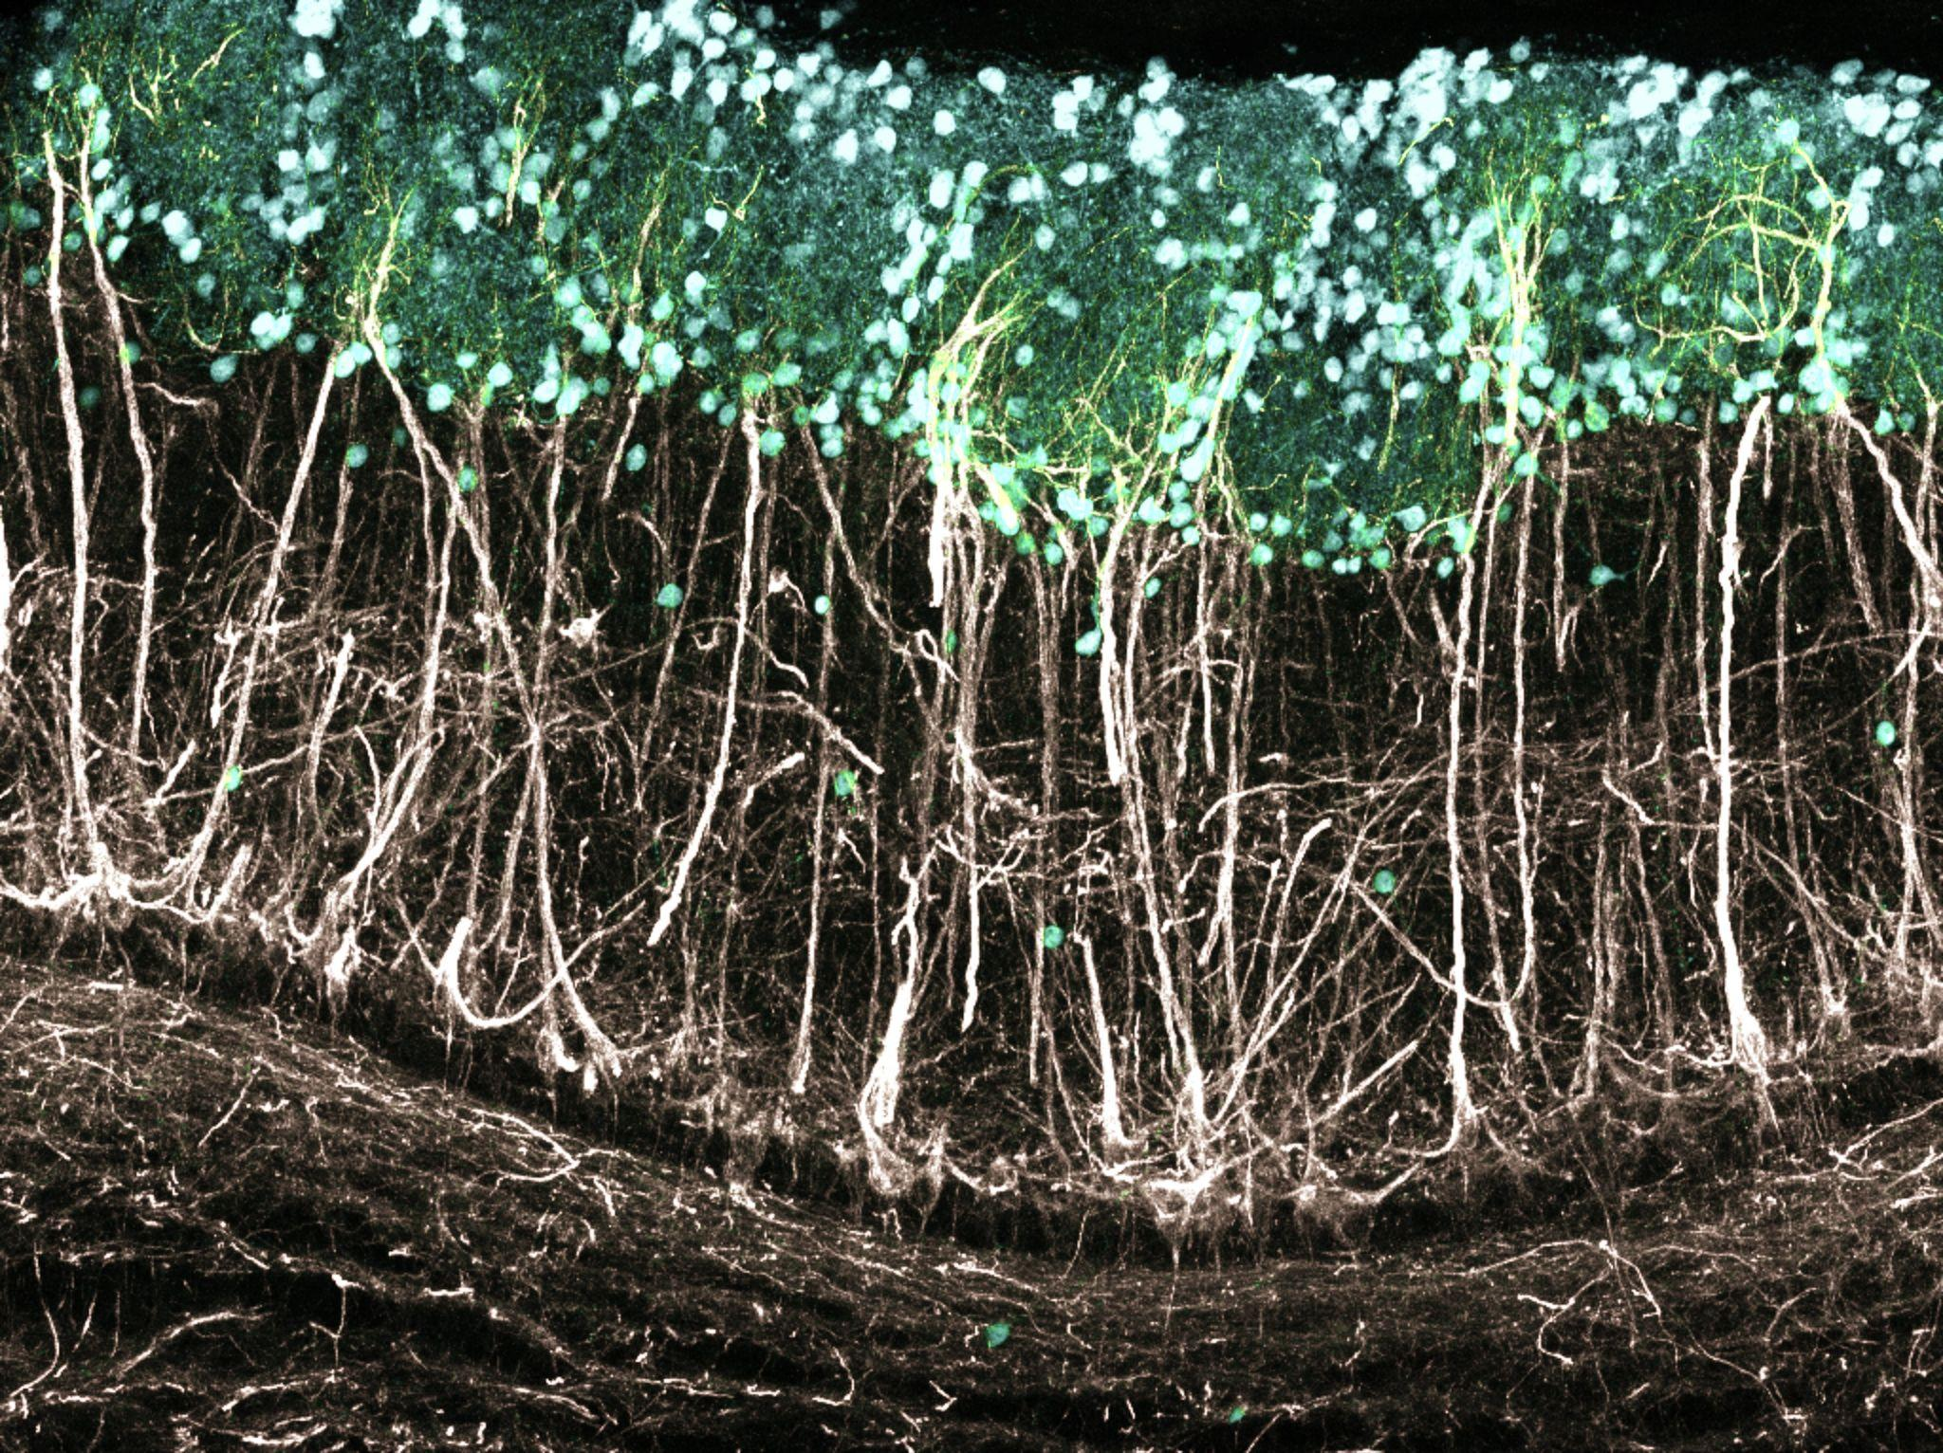
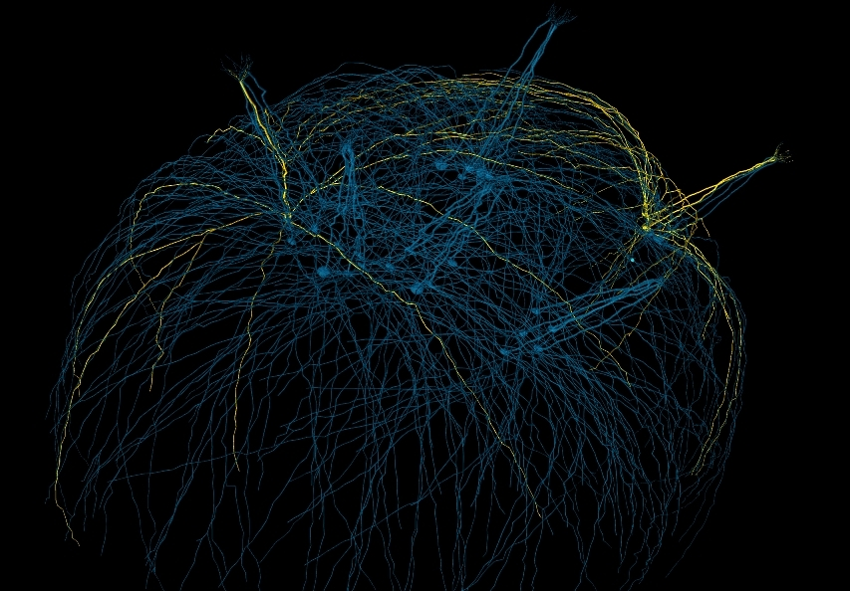
Thank you!
Special thanks to Darshan for being our tech expert!
And to all the TAs for their help throughout CAMP!
Confocal microscopic image of fixed adult mouse olfactory bulb tissue. Image credit: Li Huang and Elisa Galliano.
3D rendering of the converted network consisting of 30 Mitral cells Image credit: Migliore et al. 2014.

Slide 18
Contributions
Abhishek : Coding, Documentation and Presentation
Debarpita : Presentation Preparation
Rajkumar : Interpretation, Literature Review
Sanika : Simulation and analysis of the morphologically complex motifs
Shraddha : Modelling, Simulation

Slide 19
Modeling of
Bhalla -> 2000
Simple model with soma, prim, dend 0 and dend 1
Passive
Active
No B and C connections yet
Add GC to MC- HH,pass
Active + GC plots

